Slide 1
September 26, 2019
Dispatched 20:54 hours
Responded 20:55 hours
Arrival 20:59 hours
EMS Contact 23:00 hours
On Scene (Total) Time 20 Minutes
Transport to Hospital 23:20
Arrival at Hospital 23:28

Slide 2
34 yo, left shoulder pain and weakness
at home late in the evening, called 911.
The patient is extremely anxious and diaphoretic.
HTN, FH of CAD in mother.
No DM, cigarettes, or known elevated lipids.

Slide 4
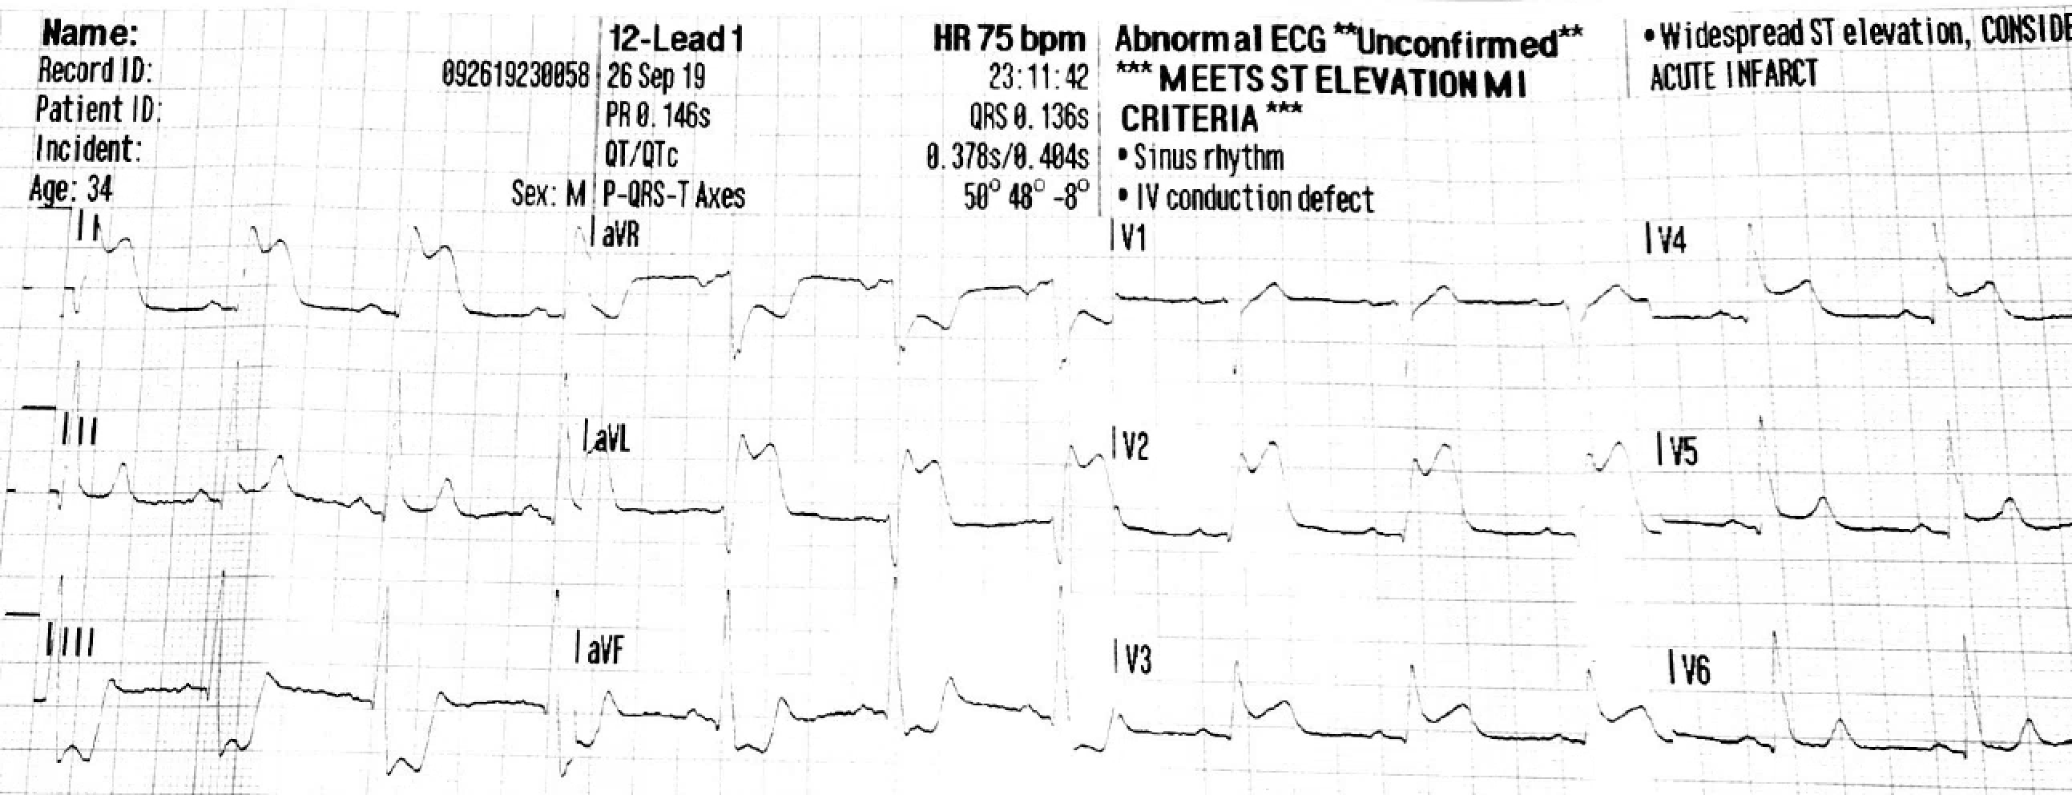
(Field ECG from CASE PRESENTATION)

Slide 5
STEMI Immediately recognized
12 lead EKG performed at 10 minutes.
324 Baby ASA PO.
IV Access.
0.4mg SL NTG administered.
Attempt to transmit 12 lead EKG.
Pt makes a moaning sound. Monitor alarms. Ventricular fibrillation is displayed on the EKG screen.

Slide 7
-Defibrillation delivered. Vfib is broken
EMS is arriving at the ER.
The Paramedic places his hand on the Pt's chest to begin compressions per ACLS.
The patient awakens, asking “What Happened?”
12 lead repeated.
The patient is moved into the Emergency Department Resuscitation Room.

Slide 9


Slide 10
Pre-hospital ECG shortens D2B time in STEMI
Diercks DB et al. JACC Vol. 53, No. 2, 2009.
U.S. National Cardiovascular Data Registry
7,098 EMS transport pts with STEMI (27.4%) and pre-hospital ECG (PHECG)
5,356 (76%) received reperfusion rx, of whom 5,117 (96%) received primary PCI
Median D2B min for PCI treated STEMI 61 min with PHECG vs. 75 without (p = 0.0001)
Strong trend toward lower in hospital mortality with PHECG vs without (6.7% vs 9.5%, p= 0.06)
Notes:
Population based linked cohort study from national registry in United Kingdom
NCDR data from US (JACC Vol. 53, No. 2, 2009) only ¼ of patients got field ECGs, but use of field ECGs associated with quicker reperfusion and strong trend toward lower mortality; 15 min shorter D2B time.
Note: when we instituted field ECGs at CKHS we noted about a 20 min improvement in D2B time.

Slide 11
Pre-hospital ECG improves survival in STEMI
Quinn T. et al. Heart 2014; 100:944-950.
Population based study in United Kingdom, STEMI n = 72,638
PHECG associated with 70% higher use of coronary reperfusion therapy
Pre-hospital time increased, in hospital time to reperfusion decreased
Hospital Mortality PHECG No PHECG OR CI
  All STEMI 4.8% 6.6% .88 .84-.93
  STEMI w/ reperfusion 4.0% 5.4% .92 .85-.99
Mortality no better with PHECG in STEMI patients who did not receive reperfusion therapy
Notes:
Population based linked cohort study from national registry in United Kingdom
NCDR data from US (JACC Vol. 53, No. 2, 2009) only ¼ of patients got field ECGs, but use of field ECGs associated with quicker reperfusion and strong trend toward lower mortality; 15 min shorter D2B time.
Note: when we instituted field ECGs at CKHS we noted about a 20 min improvement in D2B time.

Slide 12
What about the “false positive” Pre-hospital ECG (PHECT)?
False positive rate in published studies averages approx. 15% range (wide range 8%-50%)
Concerns
  Treatment delay re non STEMI conditions, eg pulm embolism, Ao dissection, hyperkalemia
  Additional hospital costs from unnecessary CCL activations – relatively minor
Overall benefits of PHECG outweigh concerns of false positive interpretations

Slide 13
Impact of the Pre-hospital ECG in STEMI
Early diagnosis of STEMI by EMS
Appropriate triage to PCI capable hospital
Emergency physician activates the cath lab team before patient arrival
Single call from operator activates the cath lab team
Significant reductions of first medical contact (FMC) to coronary reperfusion, ie “door to balloon time”
Reduction of D2B time
  less myocardium lost
  improved morbidity and mortality

Slide 14
Pre-hospital ECG is a Class I recommendation
2013 ACCF/AHA Guideline for the Management
of ST-Elevation Myocardial Infarction
“Performance of a 12-lead ECG by EMS personnel at the site of first medical contact (FMC) is recommended in patients with symptoms consistent with STEMI”
JACC Vol. 61, No. 4, 2013 2013

